Slide 1

ARDUINO BASED RAILWAY TRACK CRACK DETECTION VEHICLE
BY
KASTURI SAI SRUSHTI 15BD1A0423
MULLAMPALLI BHARGAVI 15BD1A0434
PERI VENKATA GAYATHRI 15BD1A0440
POTHURI SRISUSMITHA 15BD1A0442
4th Year ECE A
2018 – 2019

Slide 2
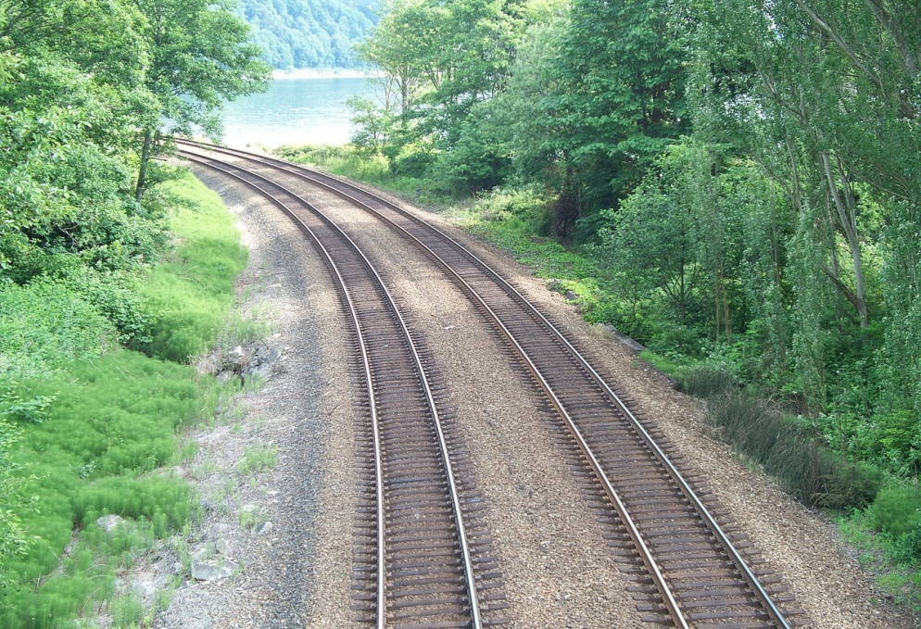
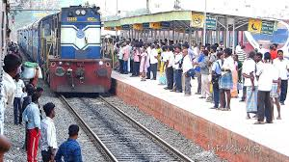
Introduction
Indian Railways is the fourth largest railway network in the world.
It is one of the busiest networks in the world transporting 8.107 billion passengers per year.
In rapidly flourishing country like India, accidents in rail road railings are increasing day by day.

Slide 3
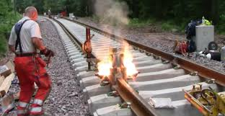
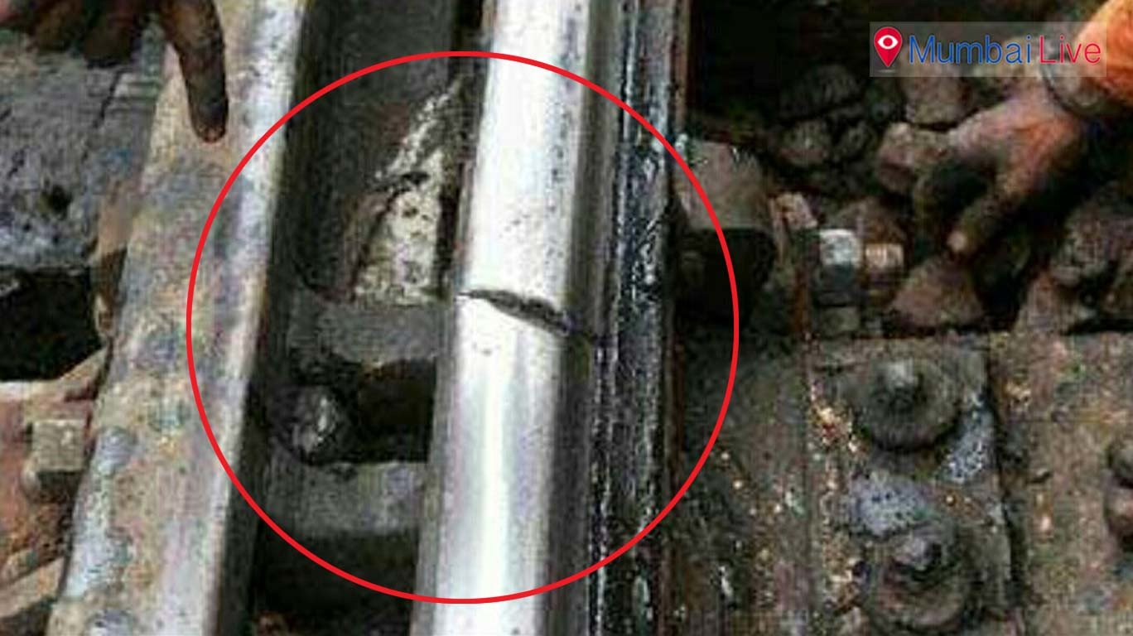
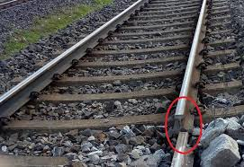
Problem in railway tracks
In India, Rail transport occupies a prominent position in quenching the ever owing needs of a rapidly growing economy.
However, in terms of the reliability and safety parameters, global standards have not yet been truly reached
The principal problem is the lack of efficient and cost effective technology to detect problems in the rail tracks and the lack of proper maintenance.

Slide 4
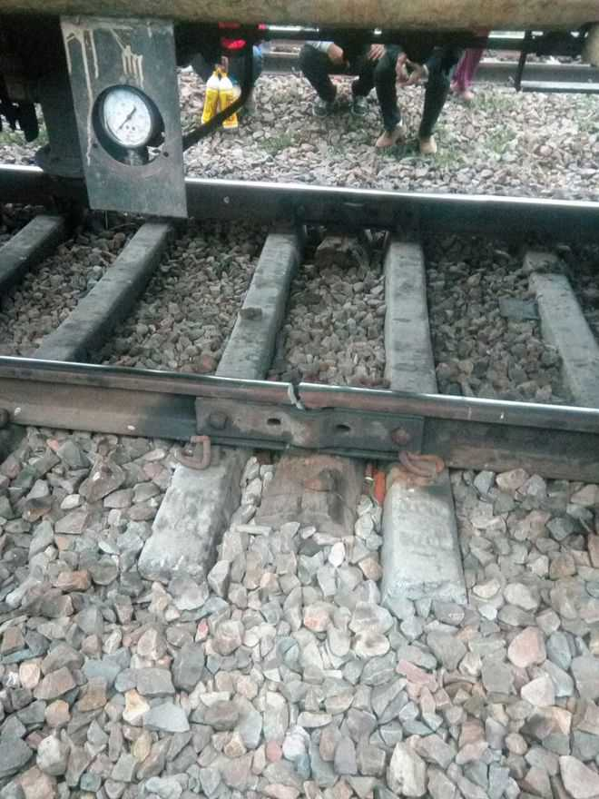
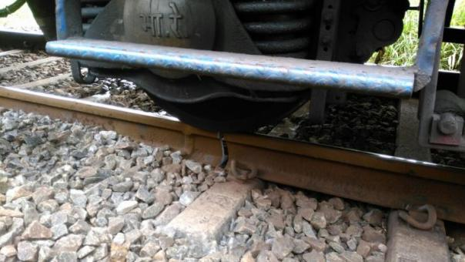
Why do cracks occur ?
Development of excessive thermal stresses in the track due to temperature variation.
Due to excessive wear and tear on account of repetitive mechanical stresses.
The insufficiency of maintenance of rails which have resulted in the formation of cracks in the rails.

Slide 5
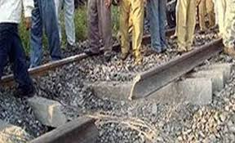
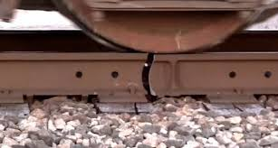
Due corrosion in track, on account of adverse climatic conditions.
Lack of Modern Management
Outmoded Technology
Due to high temperature difference between day and night in northern India cause unequal expansion and contraction of tracks in north India which leads to track weakening.
When the tensile force/ Stress exceeds its UTS (Ultimate Tensile Strength) then the tracks get fractured resulting in a crack.

Slide 6
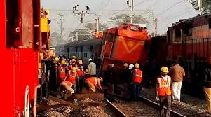
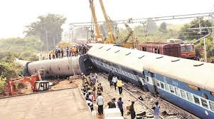
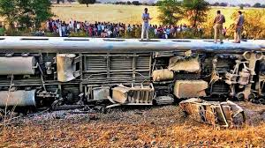
Here we can observe the adverse effects due to cracks on trains.
We can observe trains falling apart from their track .

Slide 7
Solution to solve problem due to cracks
Among the inspection methods used , the common ones are visual inspection, ultrasonic inspection and eddy current inspection.
The ultrasonic inspections are common place in the rail industry in many foreign countries
However, in the Indian scenario, the visual form of inspection is widely used though it produces the poorest results of all the methods.

Slide 8
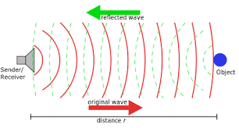
We approached to a solution based on ultrasonic inspection which will be able to detect cracks on Railway tracks and communicate the location of crack to the nearest railway station.
In this method for the detecting the cracks we use ultrasonic waves , which propagate through rail track and it detect the cracks and defects on the railway track and hence preventing the rail accident.

Slide 9
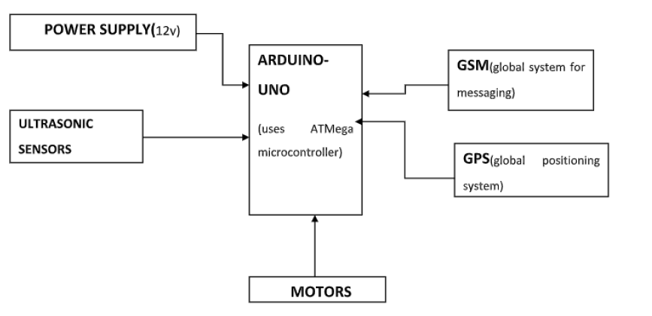
Block diagram

Slide 10
A 12v battery is used to provide required power to the circuit for its desired operation. A microcontroller used in this system and other components in the circuit require a constant 5v supply.
Arduino Uno microcontroller is used.
The detection vehicle uses ultrasonic sensors with microcontroller for its movements. Ultrasonic sensor is most suitable for obstacle detection due to its high ranging capability and low cost.
GPS and GSM are used to get location coordinates where the crack occurred and to send alert message to respective authority
Motors and drivers are used to move the detection vehicle.

Slide 11
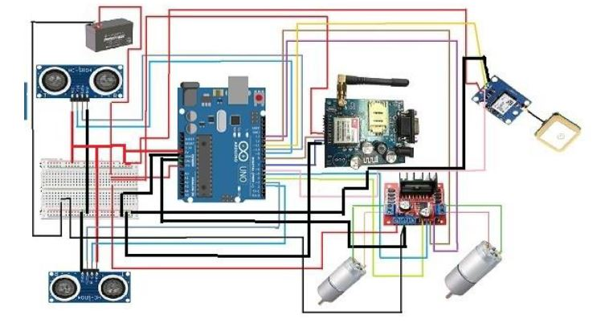
Components Used
Arduino UNO
GPS Module
GSM Module
Ultrasonic Sensor
DC Motor
H- Bridge

Slide 12
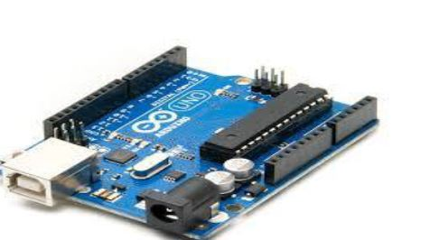
Arduino UNO
The Arduino UNO is a microcontroller board based on the ATmega328. Arduino is an open source electronics prototyping platform and it is intended for designing, creating interactive objects or environments
An ATMega Microcontroller is an 8-bit microcontroller with Reduced Instruction Set (RISC) based Harvard Architecture.

Slide 13
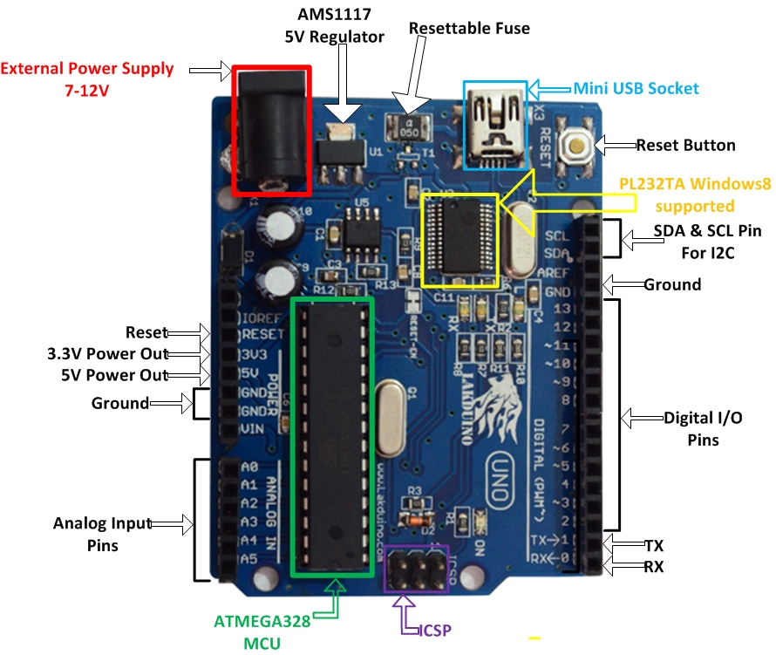
Arduino can be used to communicate with a computer, another Arduino board or other microcontrollers. The ATmega328P microcontroller provides UART TTL (5V) serial communication which can be done using digital pin 0 (Rx) and digital pin 1 (Tx).

Slide 14
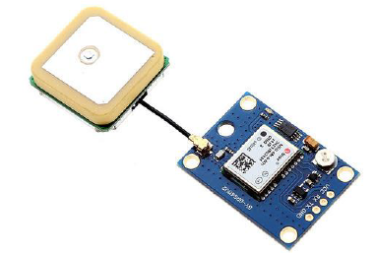
GPS Module
GPS (Global Positioning System) is a satellite based navigation system. It provides time and location based information to a GPS receiver, located anywhere on or near the earth surface.
We have used neo 6m GPS module which is used to interface with Arduino.
The GPS module for Arduino is a small electronic circuit that allows connecting to your Arduino board to get position and altitude, as well as speed, date and time.

Slide 15
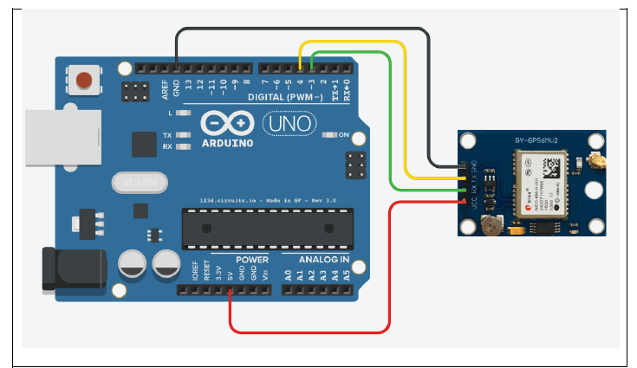
The location where crack(s) occurred is detected by GPS and this location is sent to the mobile number registered.
The latitude and longitude detected by GPS is useful to find at which railway track the crack occurred and information is sent to respective railway authority.

Slide 16
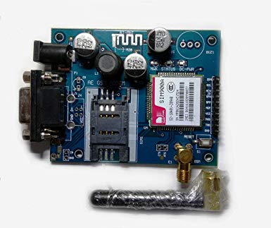
GSM Module
GSM (Global System for Mobile communication) is a digital mobile network that is widely used by mobile phone users in Europe and other parts of the world.\
Using this module, you can make audio calls, SMS, Read SMS, attend the incoming calls and internet etc through simple AT commands

Slide 17
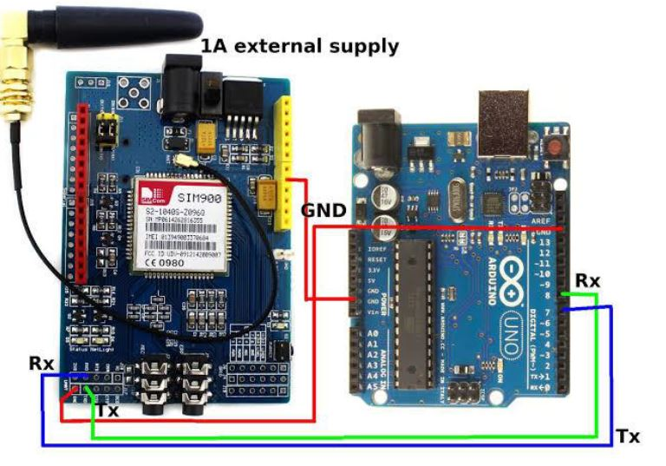
Here in our project GSM is used to send message to the registered mobile number.
The message can include alert information and also the maps link which contains the location where crack/failure of the track has occurred

Slide 18
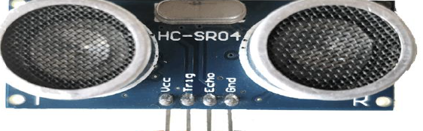
Ultrasonic Sensors
Ultrasonic sensors measure distance by using ultrasonic waves.
The sensor head emits an ultrasonic wave and receives the wave reflected back from the target.

Slide 19
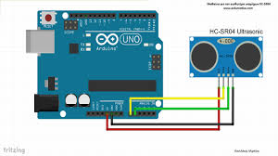
Ultrasonic Sensors measure the distance to the target by measuring the time between the emission and reception.
There are many types of ultrasonic sensors available , we have used HCSR04 ultrasonic sensor in our project

Slide 20
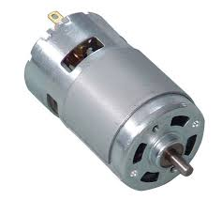
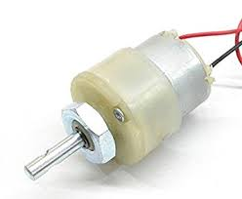
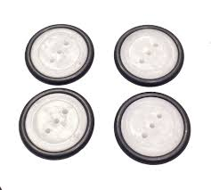
DC motor
Electric motors powered by direct current (DC) sources, such as from batteries, motor vehicles or rectifiers, are called dc motors
Motor is defined as an electric or mechanic device that can create a motion It is used to move our vehicle used to detect cracks.

Slide 21
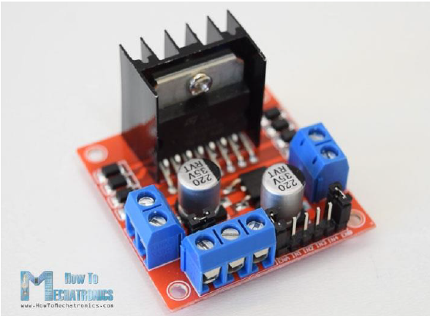
Driver
They are basically current amplifiers which accept the low current signal from the controller and convert it into a high current signal which helps to drive the motor.
While interfacing with the controller; some of the motors like DC motor, stepper motor and brushless dc motor may require a driver IC or driver circuit.

Slide 22
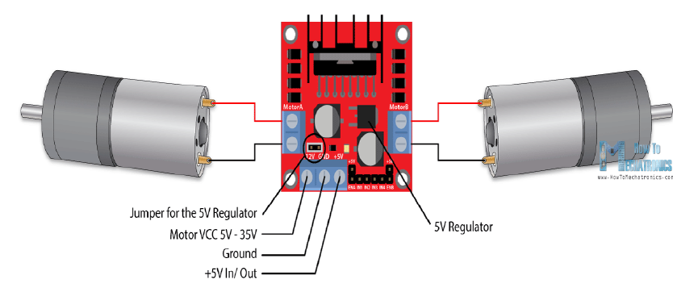
Motor require high amount of current whereas the controller circuit works on low current signals. So the function of motor drivers is to take a low-current control signal and then turn it into a higher-current signal that can drive a motor.

Slide 23
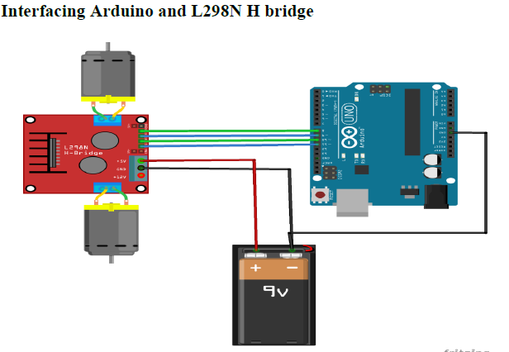
Here we used L298N driver which is a dual H-Bridge motor driver which allows speed and direction control of two DC motors at the same time. The module can drive DC motors that have voltages between 5 and 35V, with a peak current up to 2A.

Slide 24
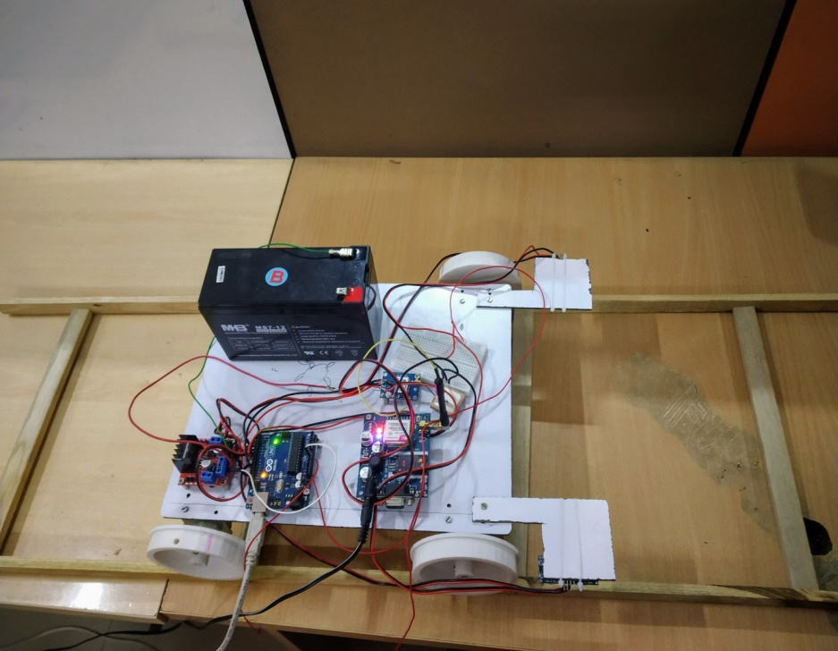
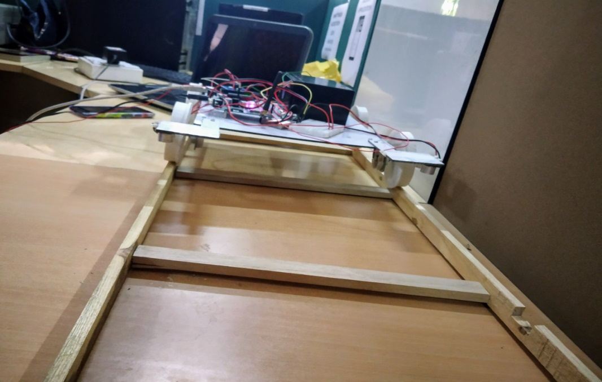
Working
Crack on track are detected by the
continuous monitoring of ultrasonic
metal detecting sensors which are
fixed at the engine.
Once detected the train automatically applies brake to stop and even pantographs could be disengaged.

Slide 25
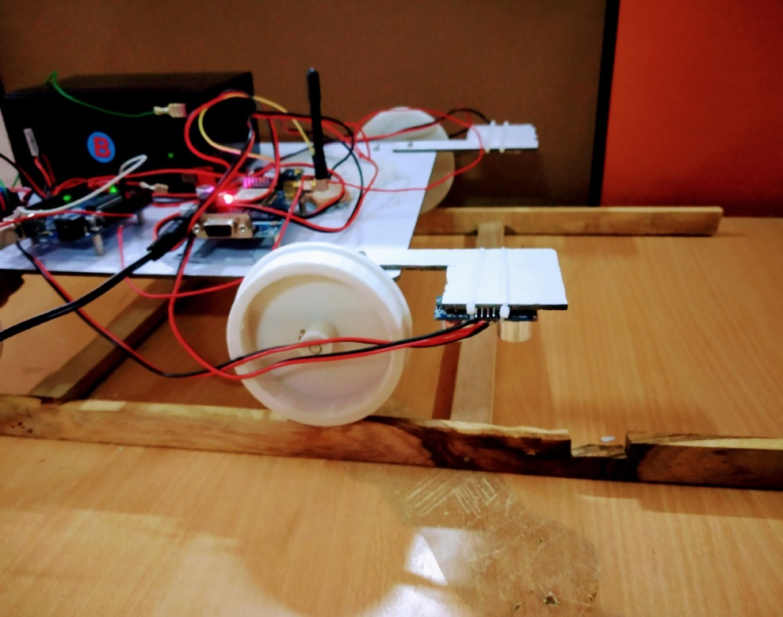
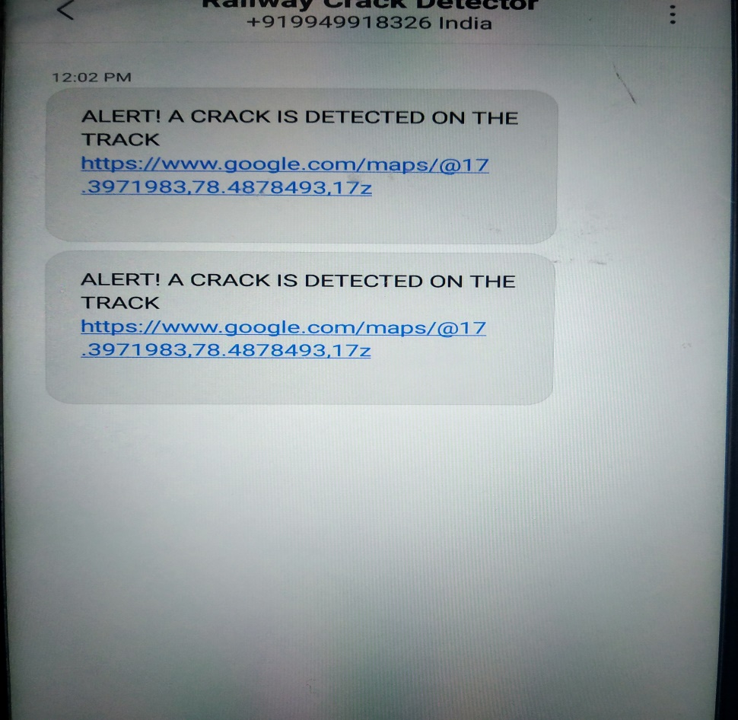
Then an alert is given to the driver and automatic emergency brake control is applied.
This module also starts GSM module to send massage to administrator.
GPS module will help in plotting the location of the crack on the google map.

Slide 26
Advantages of the Arduino based rail crack detection system
Highly efficient and user friendly design.
Easy to operate.
Low power consumption.
Location of the vehicle can be known using GPS
To detect the crack using IR obstacle sensors
GPS and GSM based tracking details sending SMS
Avoids accidents at a single track.
Efficient design.
Works anywhere in the world (GSM availability)

Slide 27
Conclusion
A cost effective, low energy embedded system, which facilitate better protection standards for rail tracks for stopping railway injuries because of cracks and barriers on railway tracks.
This technology will increase the reliability of protection systems in railway.
By enforcing these features in real time application, 70% of injuries can be averted.

Slide 28
Future Scope
CCTV systems with IP based camera can be used for monitoring the visual video captured from the track.
Embedded Systems can be developed to identify rail track fault and send messages through ZIGBEE technology.
A railway track crack repair device can be used at the site of a crack and a 3D low carbon mild steel printer can be used in filling the crack with steel material.
The material properties of 3D printed steel are tunable and combined with the flexibility and efficiency of the printing platform.
Filling cracks early would prevent them worsening and hence extend the life of the rail track surface.
By using wireless sensor network techniques and more reliable security systems can be developed and detects any abnormality in the track.

Slide 29

BY
KASTURI SAI SRUSHTI 15BD1A0423
MULLAMPALLI BHARGAVI 15BD1A0434
PERI VENKATA GAYATHRI 15BD1A0440
POTHURI SRISUSMITHA 15BD1A0442
4th Year ECE A

